Slide 1
A/B Testing - Targeting for Email Campaign
MSMA Group 11
Qianyu Dong | Sichun Li | Xinbei Jin | Congrong Shen | Xiao Shi

Slide 2
Key Insights
The average causal effect of emails is highly significant and its size is $1.26.
Randomized check shows our email effect is randomly assigned, hence no bias would be in experiment.
Sending email to consumers who purchased wine before would have stronger effectiveness. Emails are especially effective to Sauvignon Blanc buyers.
According to scoring results, 55% of training data should be targeted.
An average customer from targeted group did his/her last purchase about 2.5 months ago, spent an average $94 on Chardonnay, $28 on Sauvignon Blanc and $31 on Cabernet Sauvignon.

Slide 3
Methodology
Conducted randomization check to test whether experimental manipulation is assigned randomly to all baseline variables.
Used slice and dice analysis to illustrate the potential for targeting on responses for the email campaign.
Built causal forest model to obtain best estimates for causal effect and make individual-level predictions. (X: "last_purch", "visits", "chard", "sav_blanc", "syrah", "cab"; Y: “purch”; w: “group”)
Score = 30%(Margin rate)*Lift - 0.1(Cost), where Lift is the prediction of causal forest, which equals to the variance between purchase with email and purchase without email.
Targeting via Scoring: target consumers whose score > 0.

Slide 4
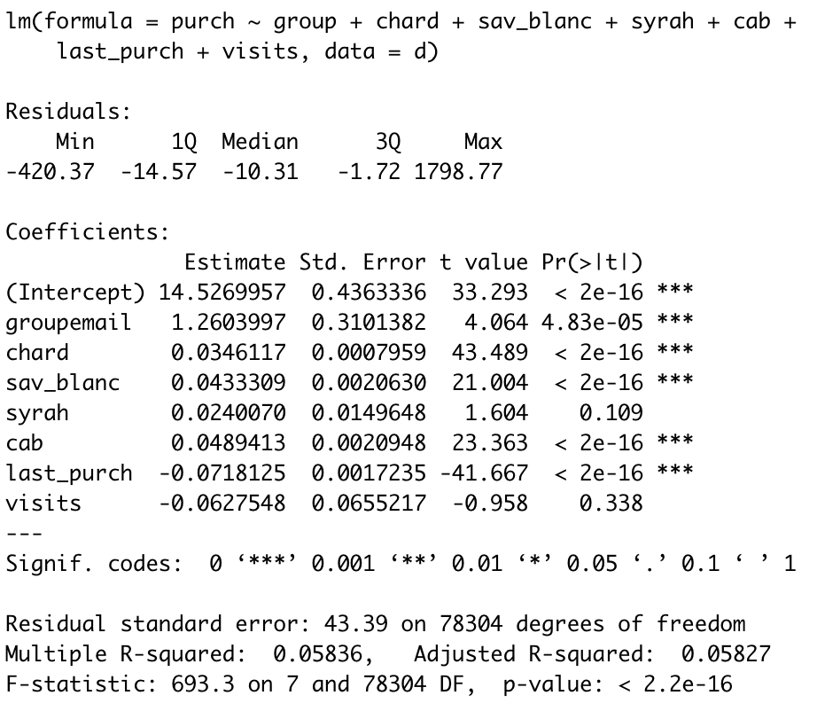
Average Causal Effects
The experimental manipulation (“group”) passed the randomization check
Customers spent $14.53 without receiving the emails
The effect of emails is highly significant and the effect size is $1.26
Past purchases of chard / sav_blanc / cab and the amount of last purchase are also significant
* Variable “past_purch” is dropped because it is perfectly collinear with the purchases by categories

Slide 5
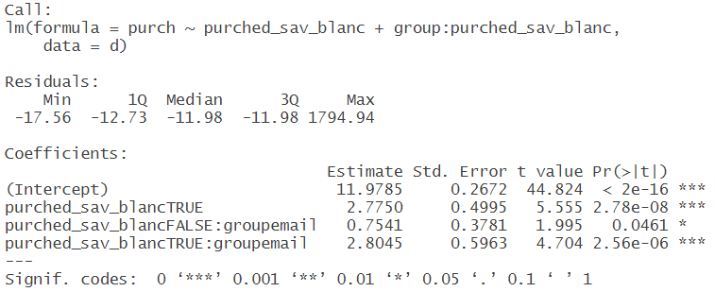
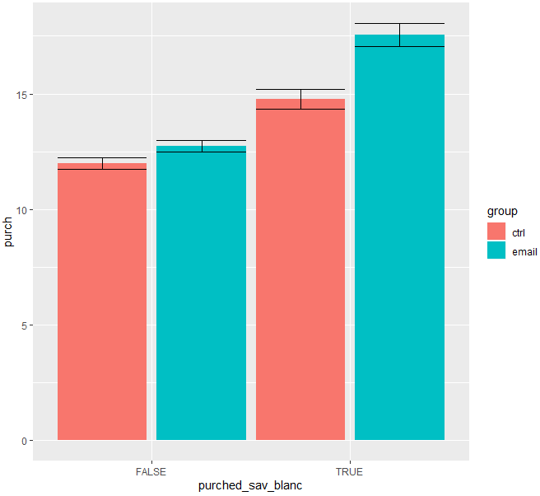
Slice and Dice Analysis
Effect of email is significant to both “have purchased Sauvignon Blanc” group and “haven’t purchased Sauvignon Blanc” group.
Emails are more effective for consumers who purchased Sauvignon Blanc, bringing a purchase lift of $2.80, while for those who haven’t purchased Sauvignon Blanc, emails can only raise the purchase by $0.75.

Slide 6
Summary of Target Customers
According to scoring results, 55% of training data should be targeted.
targeted | 43,103 | 55%
non_targeted | 35,209 | 45%
An average customer from targeted group did his/her last purchase about 2.5 months ago, spent an average $94 on Chardonnay, $28 on Sauvignon Blanc and $31 on Cabernet Sauvignon.
istarget | last_purch | vistis | chard | sav_blanc | syrah | cab
targeted | 72.90017 | 5.659142 | 93.69655 | 28.16207 | 2.298140 | 30.50920
non_targeted | 111.06251 | 5.631969 | 49.91804 | 24.94670 | 3.504276 | 22.76584
* “last_purch”, “visits”, “chard”, “sav_chard”, “syrah”, “cab” are average values.

